Slide 1
Operational Reports
June 2022 Information
July 14, 2022 Board Meeting
Notes:
Reports based on Head Start - not NCPreK

Slide 2
Highlights
Children’s Services staff received bonuses paid out on June 10th based on time of service.
Less than 1 year of service = $750
1-3 years of service = $1000
3 years and over = $1500
CCP Change of Scope is complete. EHS/HS Change of Scope is pending the budget.
Children’s Services Management team has developed the committees, meeting formats and questions for the Self-Assessment.
Should receive the Certificate of Occupancy any day now for Forest City Children’s Center (24 EHS children).
Flat Rock Children's Center temporarily closed due to staffing starting July 1, 2022. The EHS infant room will move to our King Creek Children's Center. The families in the FRCC toddler room will be working with Enrollment for placements in other classrooms.
WNCSource CCP partnership site Little Blessings in Rosman is opening a new EHS classroom in July. This new room will be able to serve four more EHS children (thanks to the EHS expansion grant).
Notes:
Quick Snapshot from month by CS Director????

Slide 3
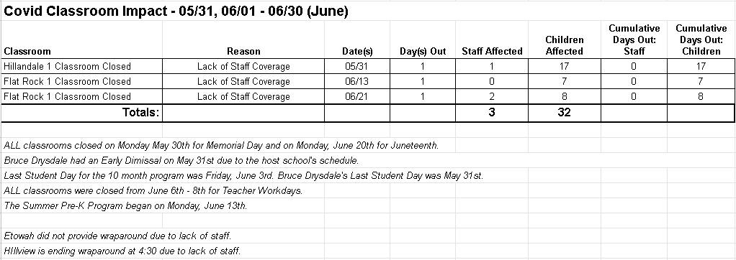
Incidents Requiring Classrooms to be Closed
Notes:
Classroom - Dates - total days - reason - children impacted

Slide 4
Staffing Updates
Staff Hired:
Patty Burgess, Early Intervention Coordinator
Katie Goodman, EIS - Development
Erika Condado, CDA Pathway Trainee
68 Staffing Positions Open for currently licensed sites.
Staff Departing:
Valeria Salazar, CDA Pathway Trainee @ Etowah
Resignation on 6/3
Crystal Watts, EIS - Classroom Support
Resignation on 6/6
Notes:
Include date
Hired with position
Left with reason for leaving
Example:
Jackie Quinones, After School Teacher @ Flat Rock (12/08/21)
Charlotte Rice, Coaching Coordinator - Retirement (12/03/21)
Megan Palmer CDA Trainee
Jordan Garcia CDA Trainee
Terri Richer CDA Trainee
Dominique Stricklin CDA Trainee
Janette Adriano - Early Head Start Teacher at King Creek (3/25) Resignation
Katie Robinson; CDA Trainee

Slide 5
Staff Health & Wellness
Wellness Team completed UCLA’s Staff and Organizational Wellness Program. (Bobby K, Sherie P, Linda C, Heather B, Shannon K, Amy P)
Current Goal / Objectives we are working on:
To reduce the % of staff that self-report work stress that exceeds their ability to cope (always, most of the time, or sometimes) by promoting a mindful health culture
By September 1, 2022, we will implement training and support systems so that staff can identify at least 3 different resources to reduce their stress.
Conscious Discipline will be a part of our Pre-Service to provide training to staff.
Possibly partnering with efforts of Raising Resilience WNC
By December 31, 2022, we will increase the participation of employees by 25% in the Wellness Program, hence reducing work stress that exceeds their ability to cope.
Testing out ideas at Etowah
Researching rewards to use including gift cards (staff requested)
Monthly destressing ideas being pursued.
Adding new members (Caitlin CE, Claudia C, Sarah H, Adrienne C)

Slide 6
Professional Development Updates
Trainings provided for our staff in June:
DHHS Hygienist provided virtual dental training to EHS staff.
LETRS Administrators Training
Leadership Education & Development Summit attended by 3 staff.
Family Partnership Agreement Training provided to Family Advocates & Supervisors
Introduction of Head Start added to Orientation for new staff
Coming Up:
1st EHS Community of Practice meeting
EHS staff receive training from Teaching Strategies on the Assessment Cycle
Supervisor Trainings on
Reflective Supervision
Individual Professional Development Plans
5R’s for Learning Leaders
Pre-Service in August being planned
Conscious Discipline will be onsite for 1 full day for staff and 1 evening for families!
Notes:
How are we using our T/TA funds?
Program Goal: D. 100% of Family Advocates and Home-Based (Parent Educators) staff will be trained in Family Development Model to maintain a strengths-based approach to working with families.
Share progress annually in June
Report on goal regarding trainings that we have offered around cultural diversity … 2 times a year.

Slide 7
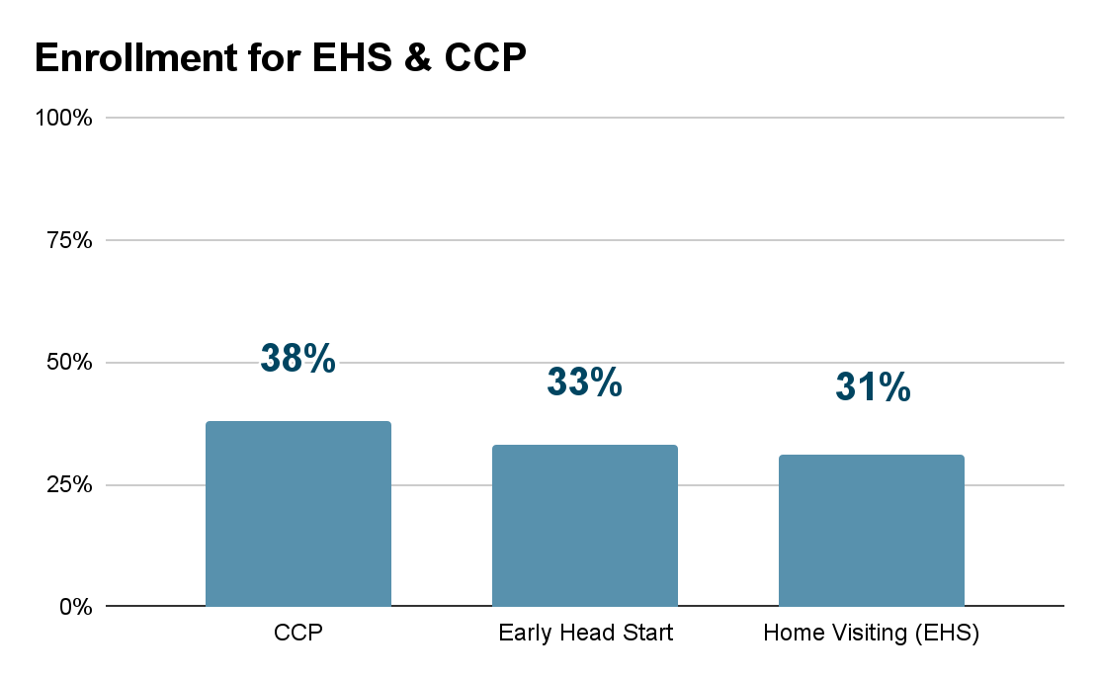
Enrollment
Overall Enrollment
The 2021-2022 Program Year for Head Start/NC Pre-K ended on June 3, 2022.
Our overall Enrollment across all programs is at 40%. Enrollment percentages are provided in the chart.
Home Visiting (EHS) - 38 %
Early Head Start (Center-Based) - 33%
EHS/CCP - 38%
Waitlist
406 Participants - Some children are Waitlisting for multiple program options.
53 Families are Waitlisted for the Home Visiting Program
140 Children are Waitlisted for the Early Head Start or CCP Program
271 Children are Waitlisted for Head Start or NC Pre-K Program
During the months of May & June we received and processed 123 new applications for enrollment.
Notes:
Enrollment information with any reasons for enrollment shortfalls

Slide 8
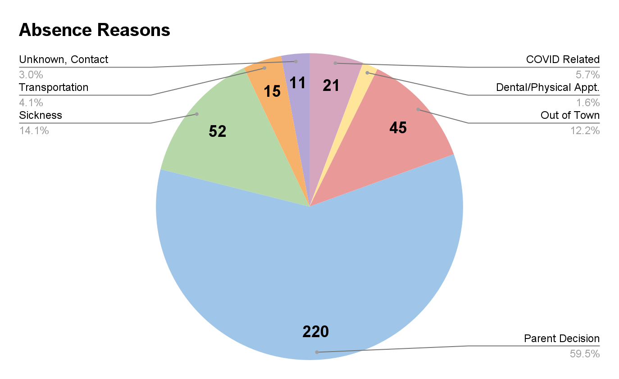
Attendance
June 2022
Average Attendance by Program Type
CCP Average Attendance 72%
EHS Average Attendance 69%
Head Start & NC Pre-K ended on June 3, 2022
Absence Summary
Total number of 370 Absences in June 2022
Family Advocates, Site Supervisors & Teachers have been doing a great job with following up with families who have multiple absences. Where needed, staff have worked with the families to create an Attendance Success Plan.
Notes:
Attendance information with any reasons for shortfalls

Slide 9
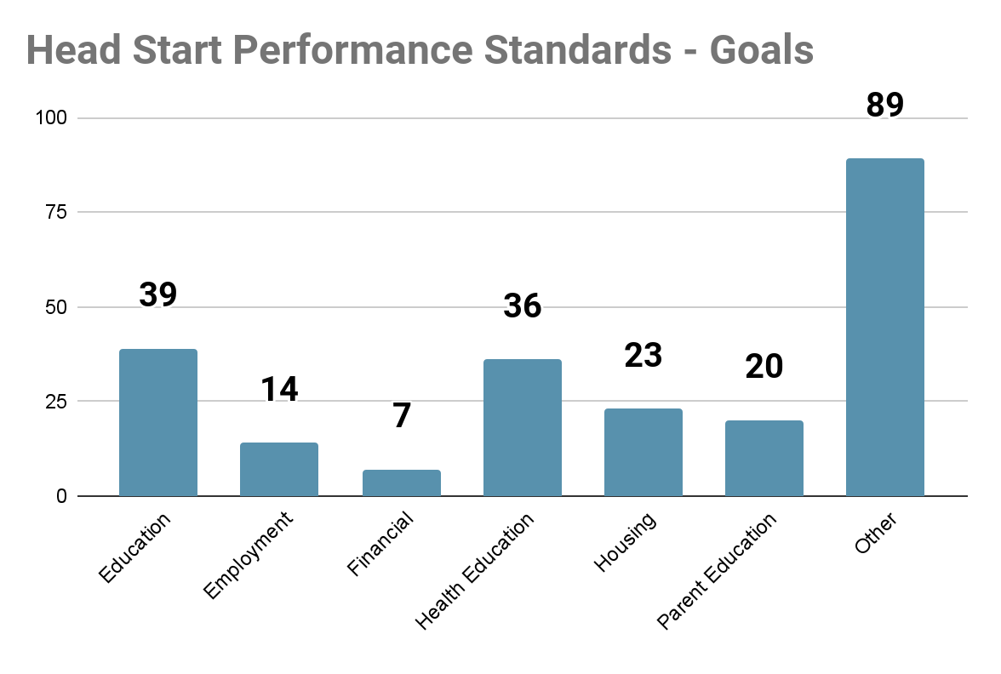
Family Partnership Agreements
During the 2021-2022 Program Year
228 Family Goals were created
148 Individual Families created at least 1 Goal during the Program Year
81 Goals were Completed
The 7 areas that Head Start wants us to report on, in regards to Family Goals, are:
Education
Employment Opportunities/Job Training
Financial Education
Health Education
Housing Assistance
Parent Education
Other
Notes:
Monitoring updates with any quality and compliance issues that need to be addressed and how they will be addressed.
Common goals developed
Progress made towards goals

Slide 10
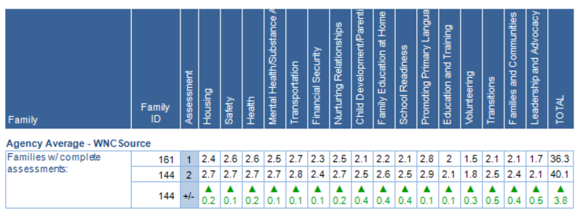
Family Strengths & Needs
Scoring
1 - In Need
2 - Adequate
3 - Strength
The average scores on the Family Strengths & Needs Assessment were all higher at the end of the year than they were upon enrollment.
Notes:
(Report 4220)

Slide 11
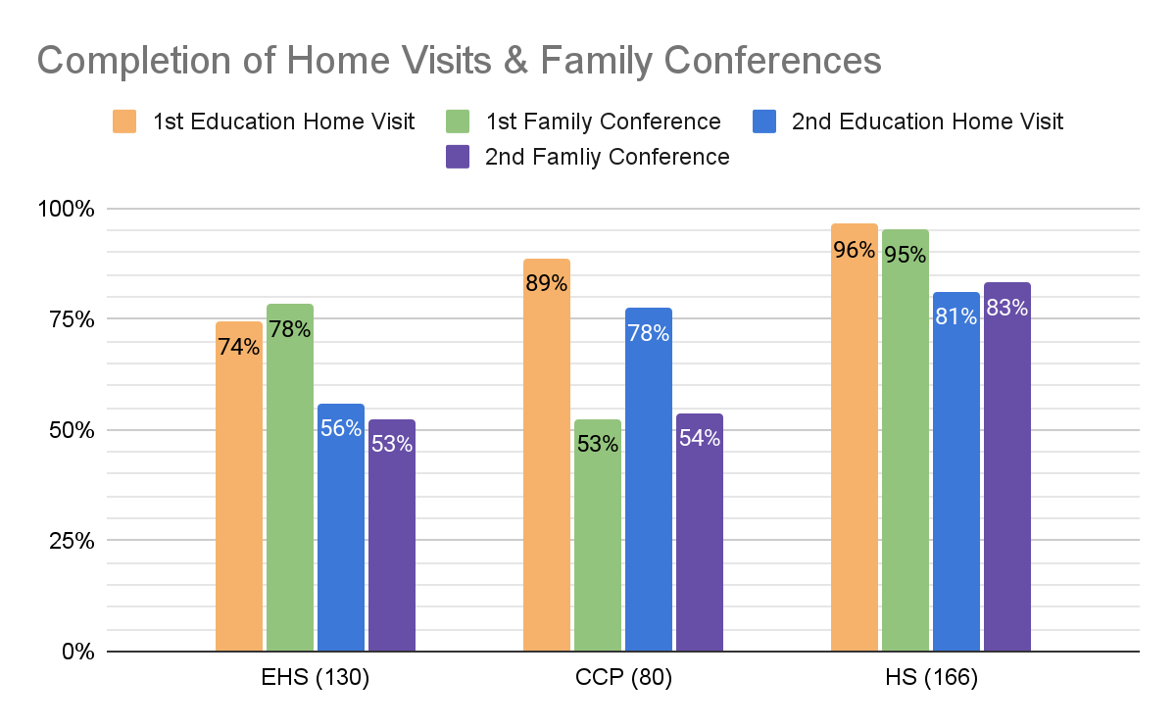
Family Engagement in Children’s Education
1st Education Home Visits happens prior to the child enrolling or within 2 weeks after enrollment
1st Family Conference occurs following the child’s first child assessment checkpoint.
2nd Education Home Visit occurs following the child’s second child assessment checkpoint.
2nd Family Conference occurs following the child’s third child assessment checkpoint.
Barriers: Scheduling with families due to staff shortages. Children dropping throughout the year as staffing has dropped.
Notes:
Monitoring updates with any quality and compliance issues that need to be addressed and how they will be addressed.
Do not include NCPreK
Home Visits
Family Conferences
Sharing Curriculum with families
C. Increase Non-Federal share generated by family involvement by 30% including growth through family/child activities taking place in the home
Monthly regarding My Family App use

Slide 12
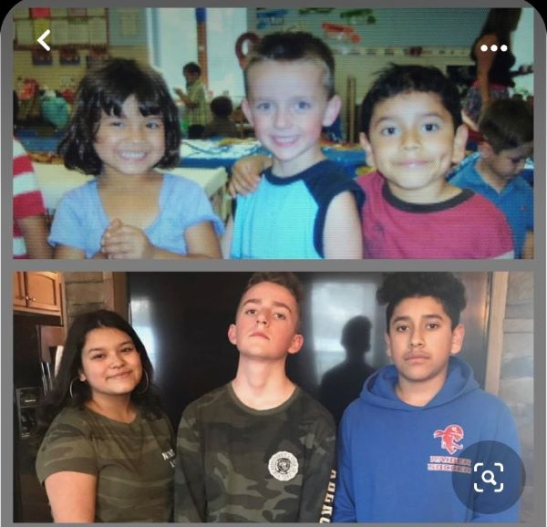
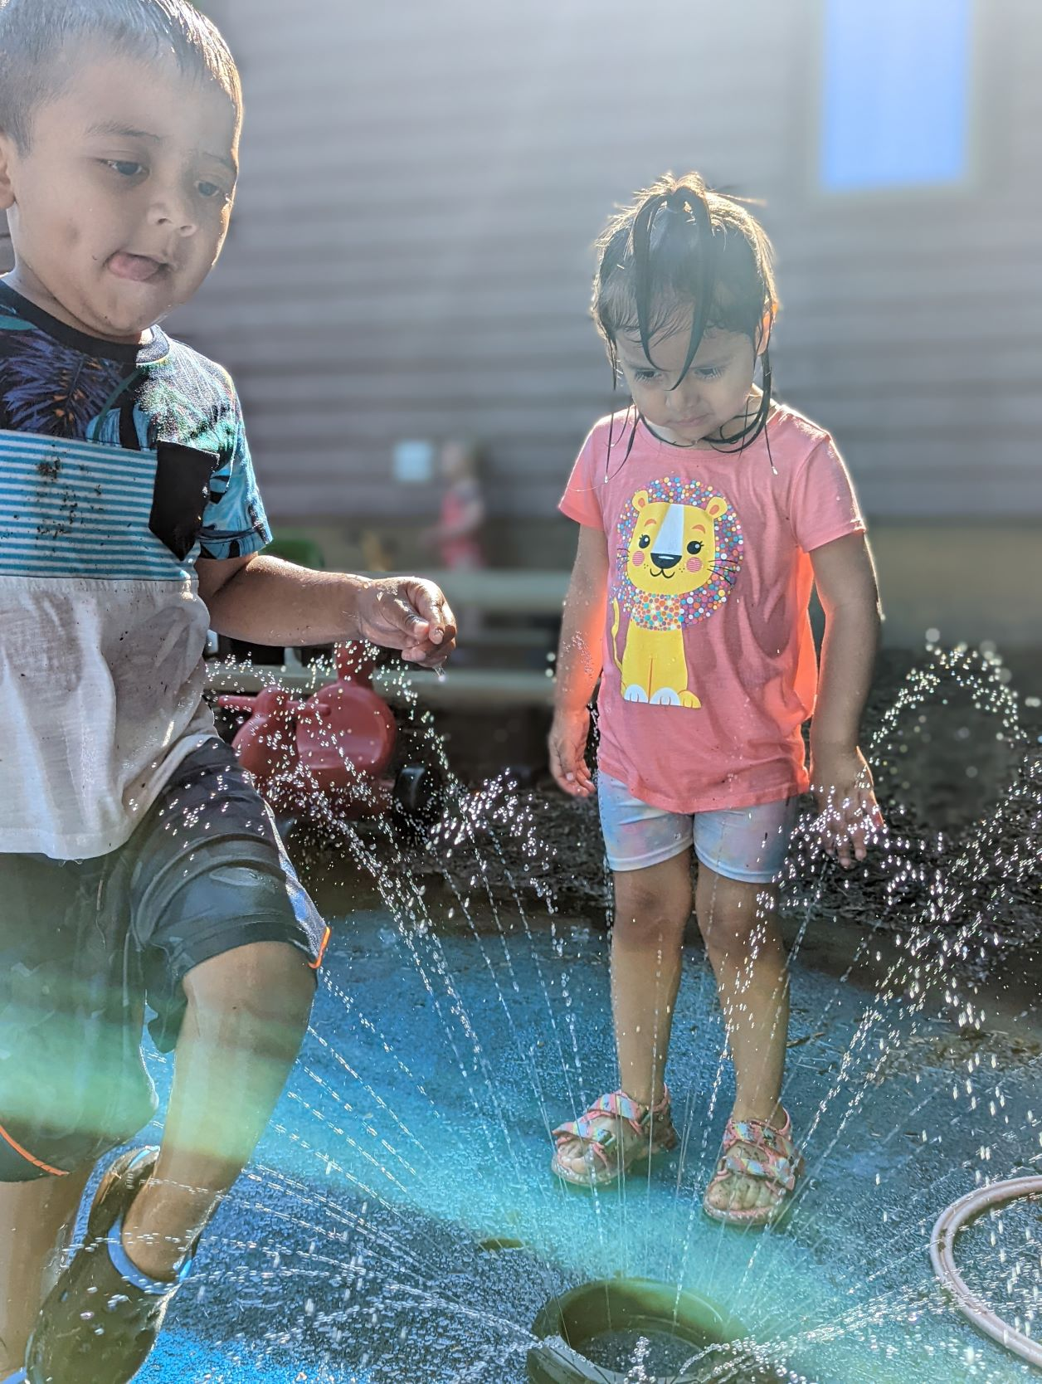
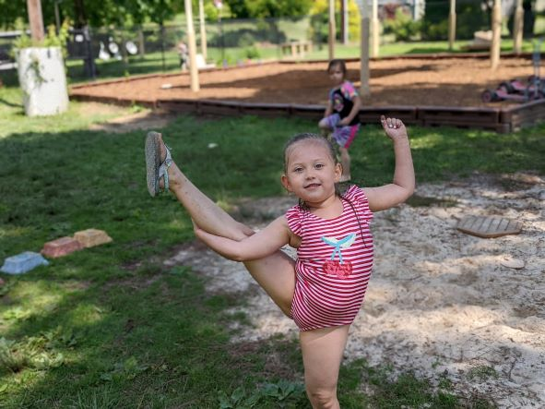
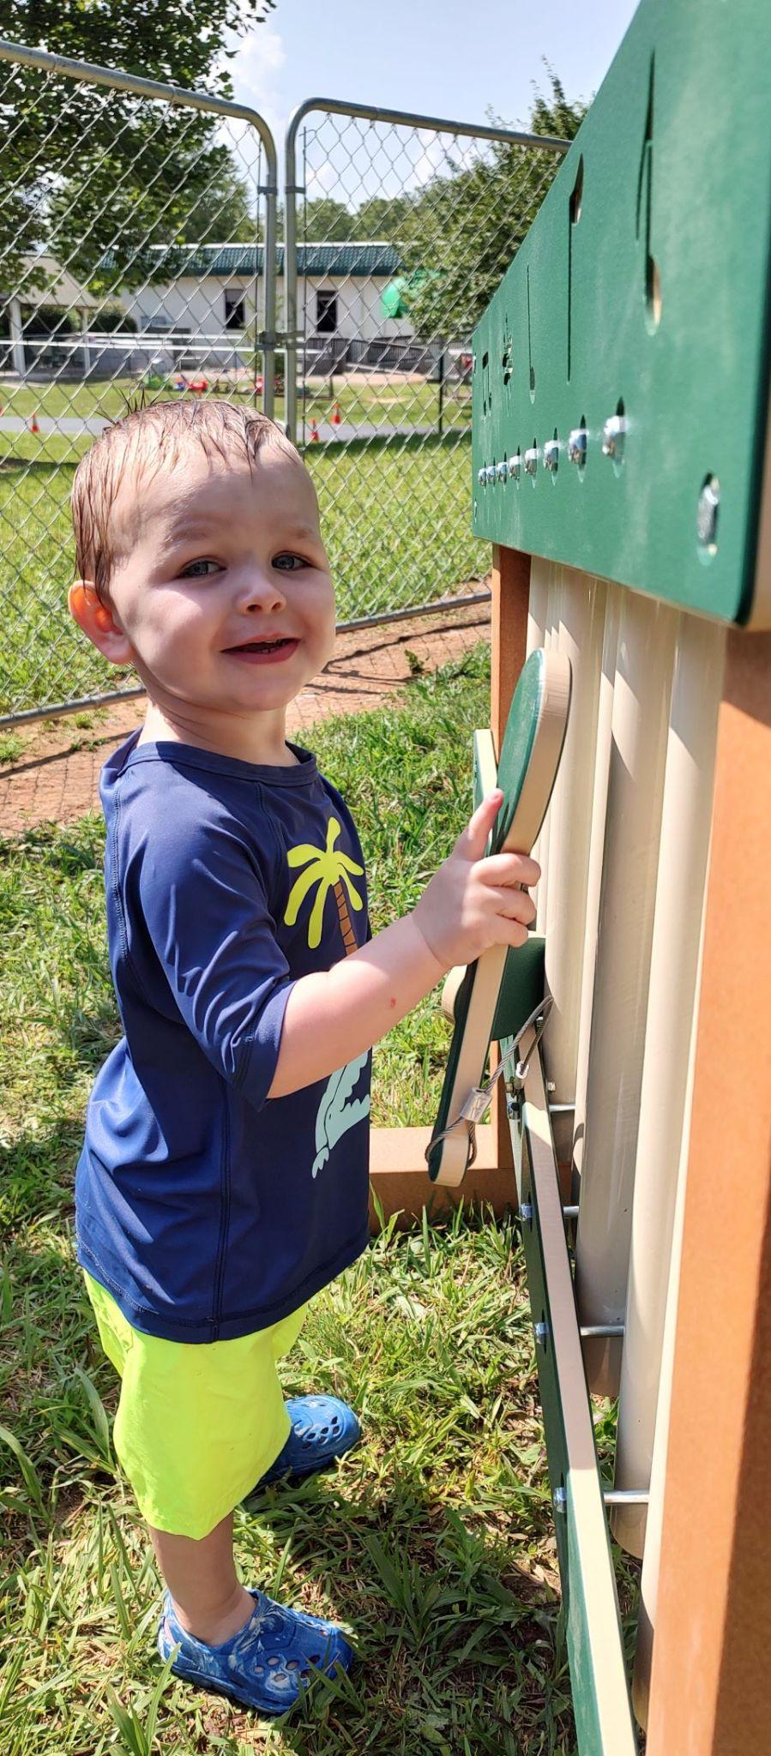
Early Head Start Updates
Reunion Story
Pictured above are Jacob Messina,
Rosa Zimmerman and Jesse Baldwin.
The children attended our Fletcher site
In 2009. They are attending West and
North Henderson High School and
remain friends today. Their parents
visited their former teachers to tell
the positive impact Head Start made
In the lives of their children and families.
ITERS and ECERS Environmental Rating Scale Assessment Results for Etowah was 6.25 and for Sugar Hill.was 6.10
June Trainings:
NHSA Leads Conference
Diversity
Tooth Brushing
Active Supervision
Building an Anti Racist Workplace
Children are enjoying outdoor activities:

Slide 13
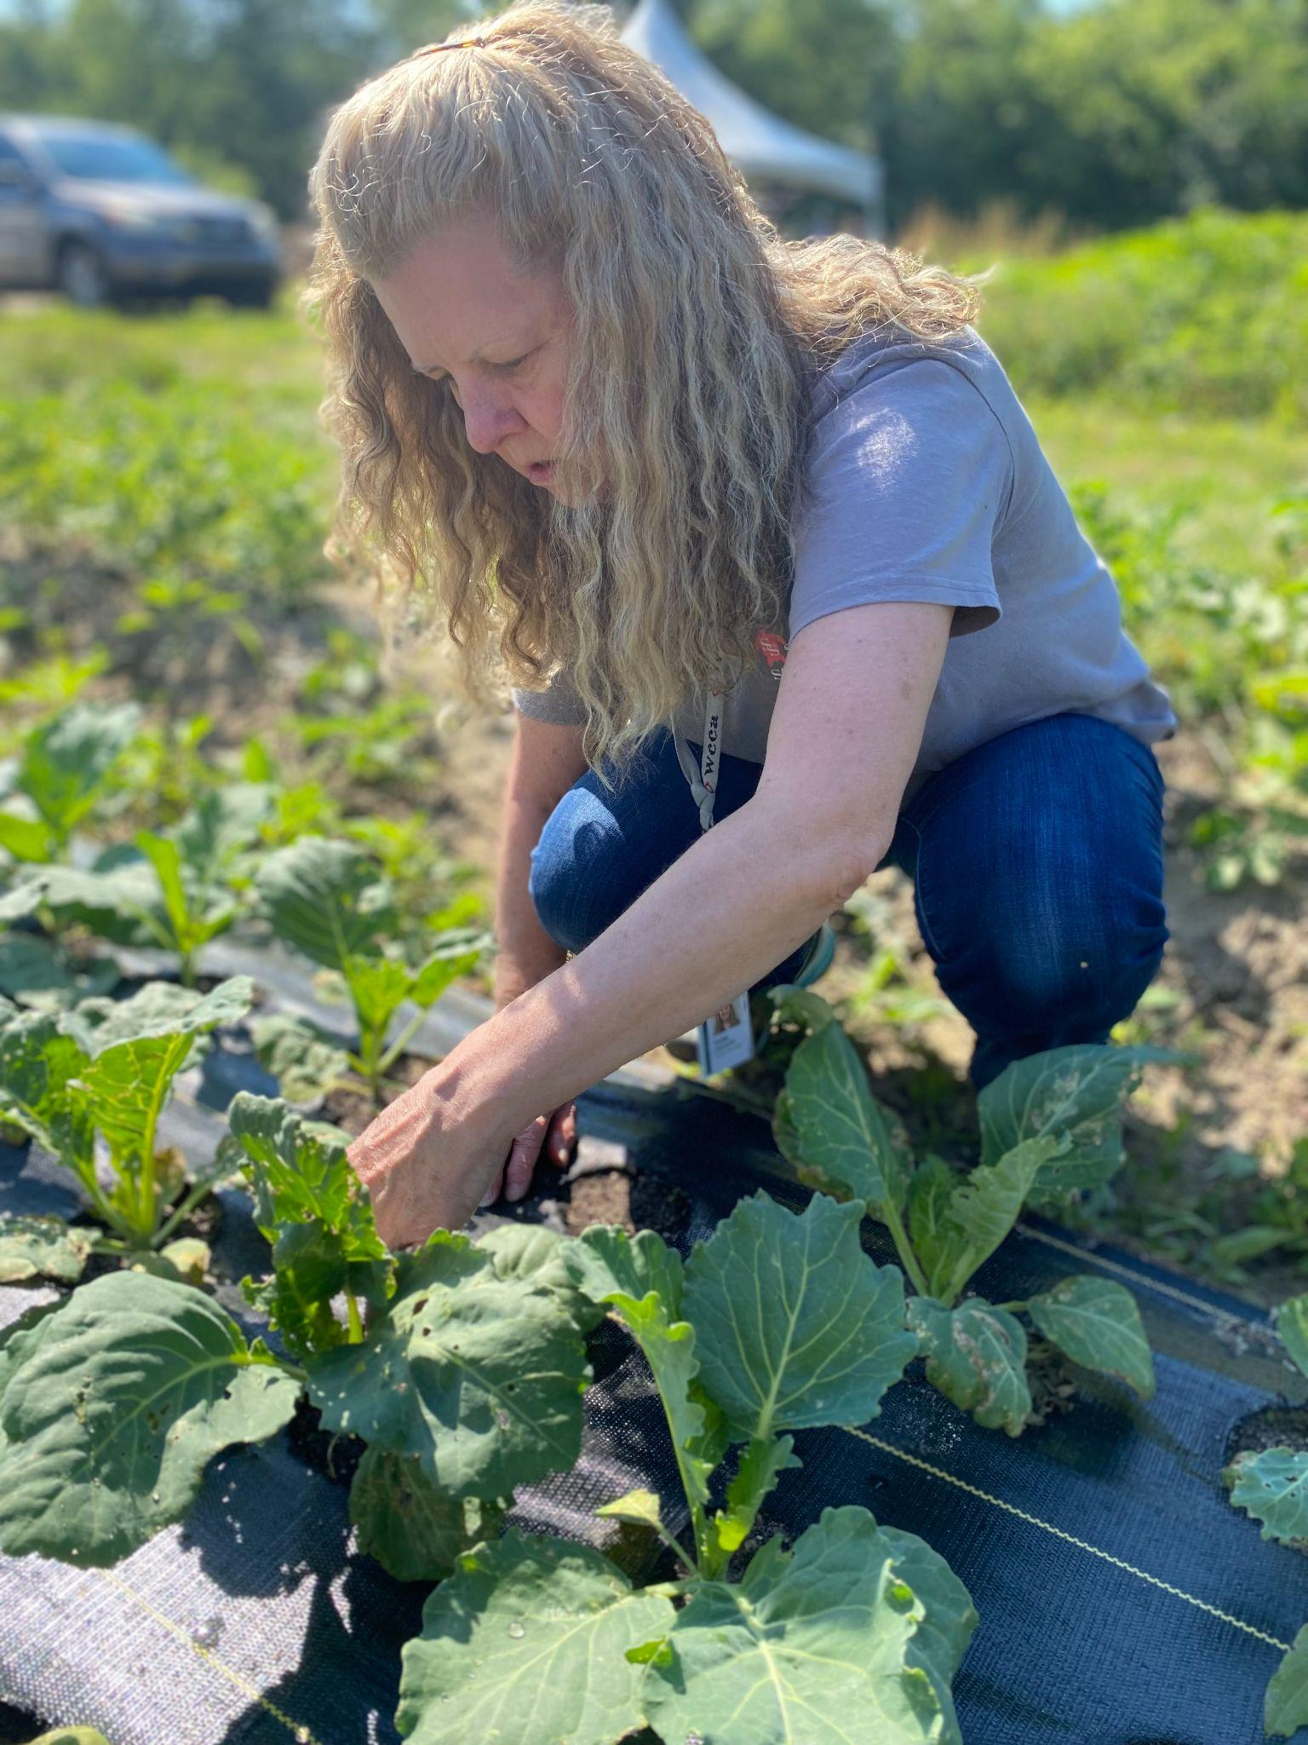
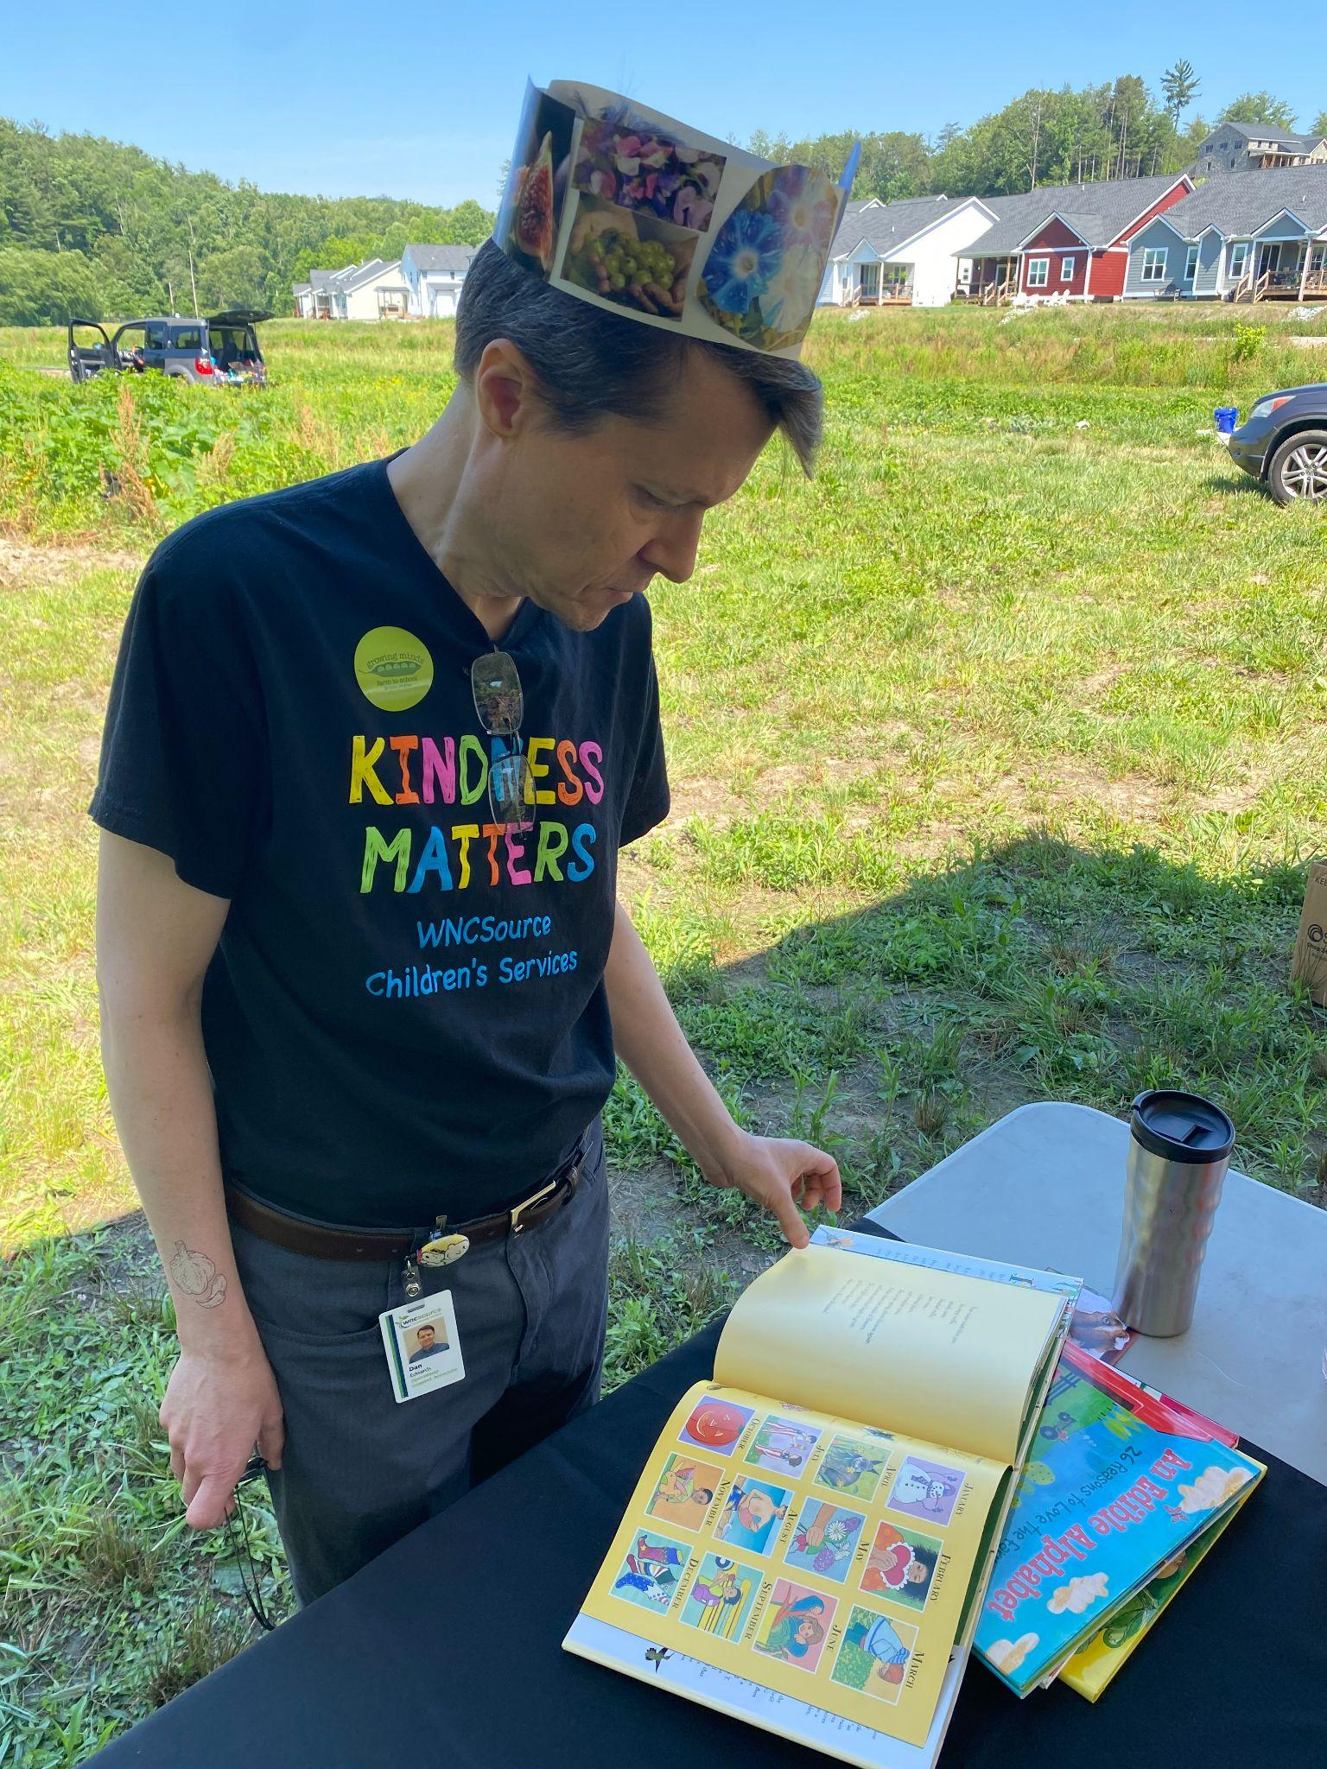
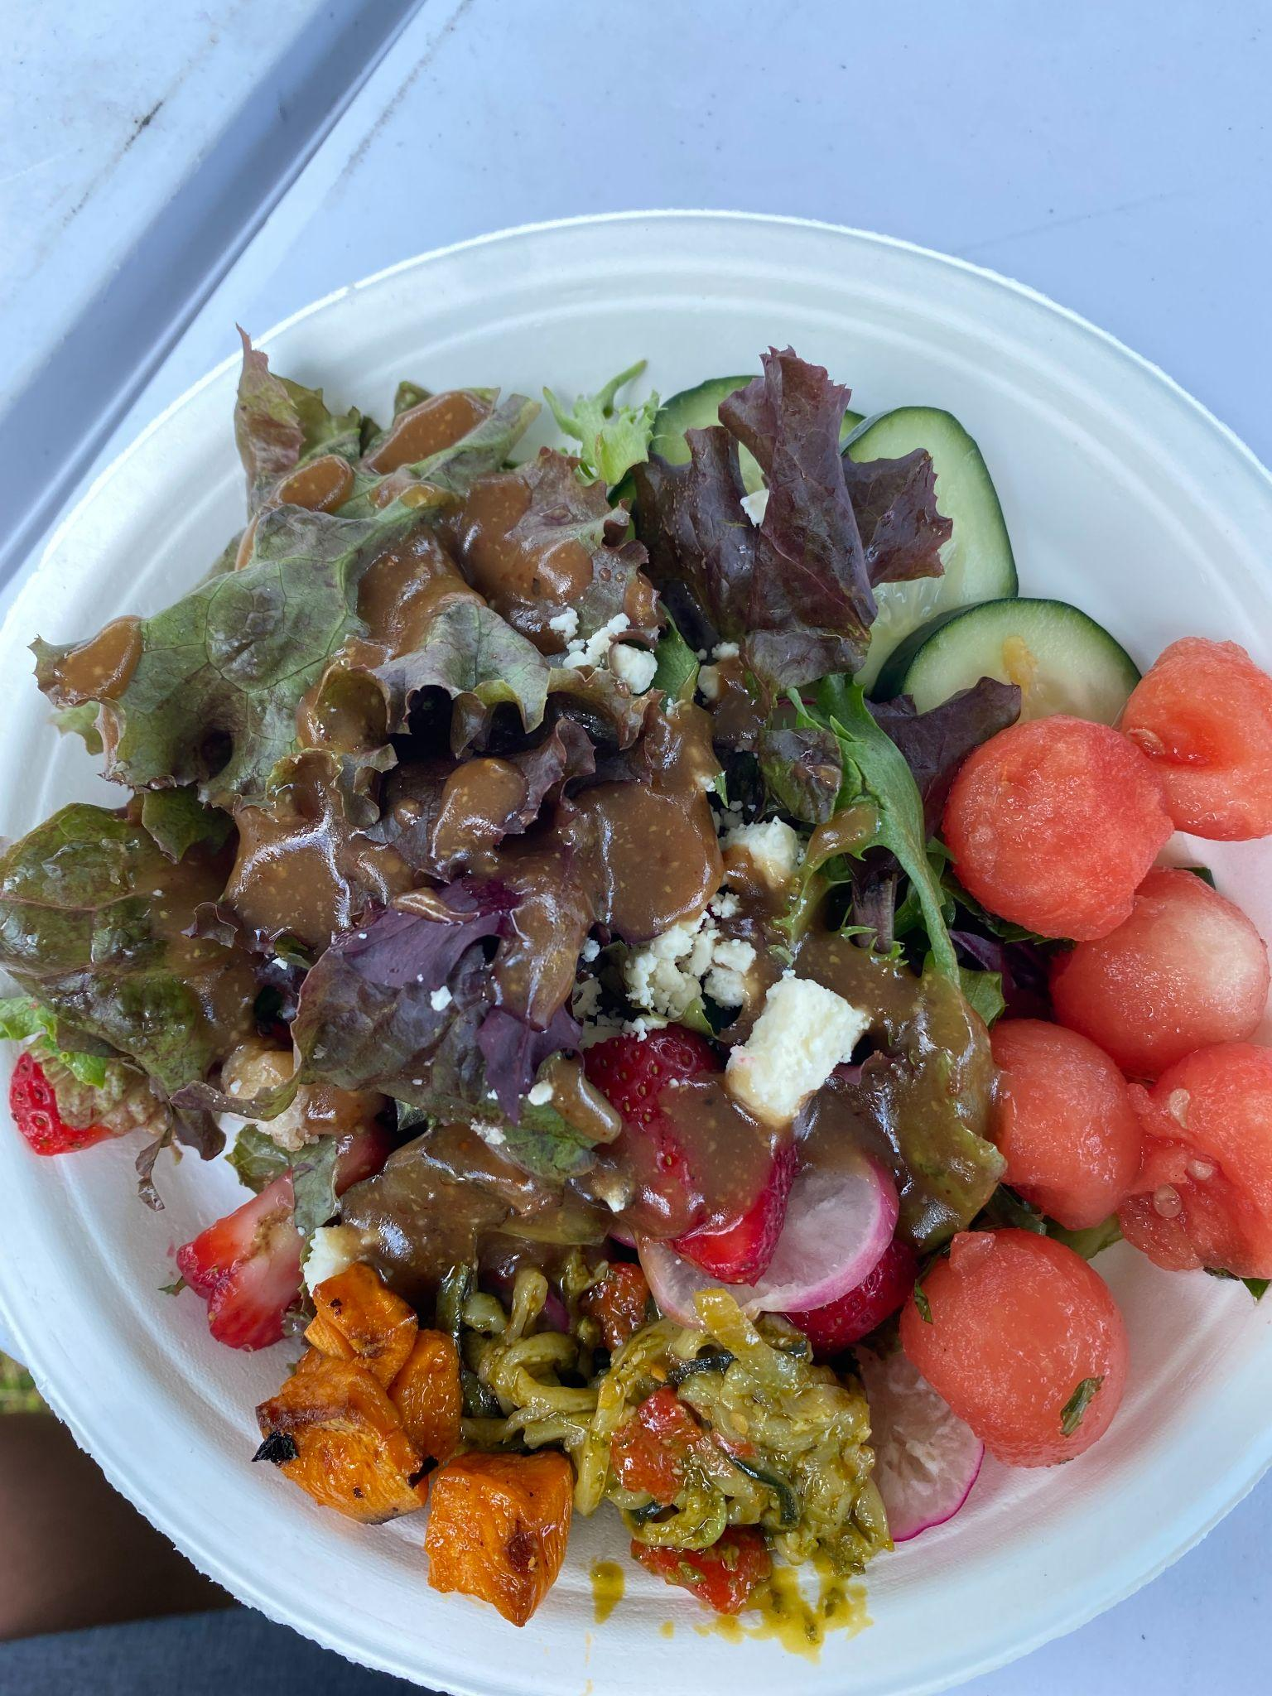
Head Start & NC Pre-K Updates
Children’s Services (non-teaching staff) “Farm Field Trip” 6/6/22
Appalachian Sustainable Agriculture Project / Growing Minds Program
Explored Tiny Bridge Farm / Tierra Fertil Coop - Hendersonville
Lunch provided by Dandelion Cafe
Participated in hands-on activities & made connections to ECE curriculum
Collaborative effort to increase staff morale and retention
Summer Hiring Focus (over 40 teaching positions open across Head Start & NC Pre-K programs)
Managers are currently finalizing staff teaching locations for 2022-23 school year
HS/NCPK teaching staff return August 15th for pre-service training & PD, planning/classroom set-ups, initial home-visits with families, etc.
Notes:
HS & NC Pre-K program updates

Slide 14
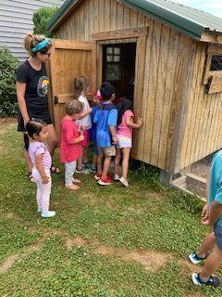
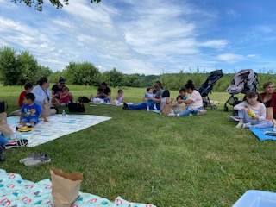
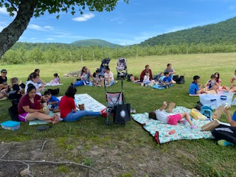
Home Visiting Program
The 2 Parent Educators are currently serving 7 Early Head Start families each during the summer (HS families are 10 months). Enrollment will increase to 12 families, when the Head Start Program begins again in August.
The HB families had a field trip to Bearwallow, which was a great success with a lot of parent engagement. The Parent Educators will complete their last Socialization with families on June 26, 2022. They plan to begin Socializations for the 22-23 program year in mid-July.

